Slide 1
Lending Club Case Study
Varun Juyal

Slide 2
Contents
Introduction
Business Objective
Data preparation and cleaning
Analysis with Observations
Recommendations

Slide 3
Introduction
Lending Club - largest online marketplace for peer-to-peer lending.
Provides an online platform for borrowers and lenders where they can transact smoothly and quickly.
Loan types - personal loans, business loans, and financing of medical procedures
Like most other lending companies, lending loans to ‘risky’ applicants is the largest source of financial loss - credit loss.
Credit loss is the amount of money lost by the lender when the borrower refuses to pay or runs away with the money owed.

Slide 4
Business Objective
Company wants to understand the driving factors (or driver variables) behind loan default, i.e. the variables which are strong indicators of default. The company can utilize this knowledge for its portfolio and risk assessment

Slide 5
Data preparation & Cleaning
• The data provided has a total of 39,717 rows and 111 columns
• Data type details - float (74), integer (13) and object (24)
• While inspecting the data set we found, there are lot of columns with missing values. Of the total fields in the data set, almost 51% of the data was missing.
• There were columns, which had all the rows as “NA”, we can completely get rid of these. The threshold for dropping column was any column with more than 40% NA values.

Slide 6
Data preparation & Cleaning
• On further analysis, we observe that there are columns with data on customer behavior after loan has been granted, these will be redundant for the analysis needed.
‘funded_amnt','funded_amnt_inv','emp_title','url','desc','title','pymnt_plan','zip_code','addr_state','delinq_2yrs','earliest_cr_line','open_acc','pub_rec','revol_bal','revol_util','total_acc','out_prncp','out_prncp_inv','total_pymnt','total_pymnt_inv','total_rec_prncp','total_rec_int','recoveries','collection_recovery_fee','last_pymnt_d','last_pymnt_amnt','last_credit_pull_d','application_type','tax_liens’.
• In addition, upon removing the “NA” values from the columns, we still had some “NA” values, which we dropped by removing some of the rows.

Slide 7
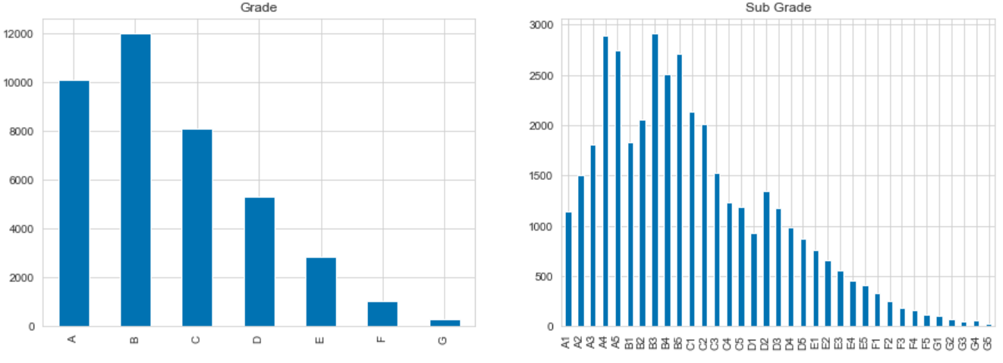
Analysis – Univariate
• Even though loan application acceptance decreases with decrease in grade, however grade B has a higher frequency than A. This could be because grade A are more affluent and fewer people need a loan.
• Within grades A & B, number of loan application acceptance increases with decrease in subgrades, while for C and lower, the acceptance decrease with decrease in sub-grades. A reason could be that for grades A & B, loans are accepted irrespective of subgrades and more applications are received with decreasing sub grades, whereas for C & below, sub grades have an impact on application acceptance.

Slide 8
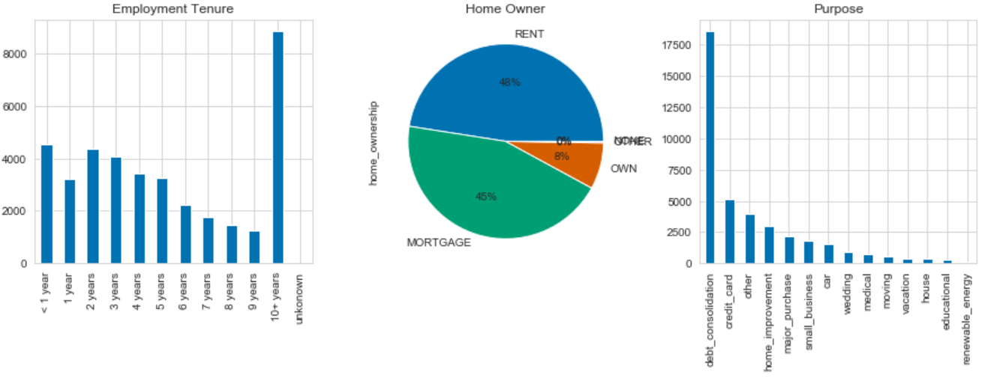
Analysis – Univariate
Loan applications accepted generally decreases with increase in years if employment, indicating more need of loan in early years of employment.
Customers with rented and mortgaged house apply and get accepted for loan the most
Most loans are for debt consolidation

Slide 9
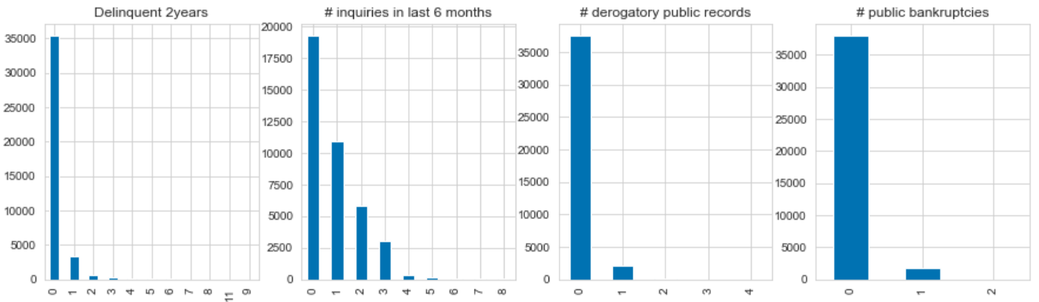
Analysis – Univariate
Loan applications are almost always being accepted for customers with no derogatory* records.
A *derogatory item is an entry that may be considered negative by lenders because it indicates risk and hurts your ability to qualify for credit or other services

Slide 10
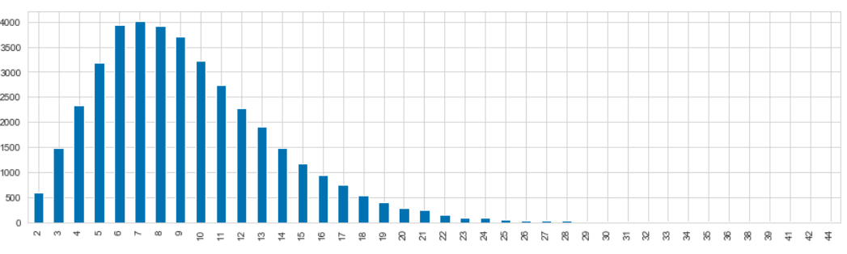
Analysis – Univariate
Loan acceptance have a tendency towards 7 open accounts* on credit file
Also referred to as “open credit,” *open accounts are a hybrid of installment and revolving credit. The payment is not the same each month, and it's usually due in full at the end of each billing cycle. The consumer satisfies financial responsibility for the account when the bill is paid in full each month

Slide 11
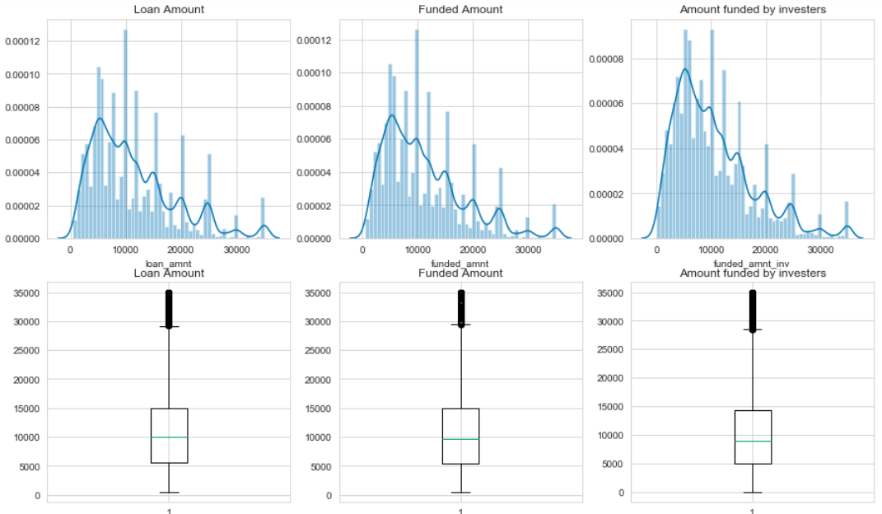
Analysis – Univariate
There are peaks at intervals possibly due to rounding off. Most loan amounts are in the range of IQR(5000-15000)

Slide 12
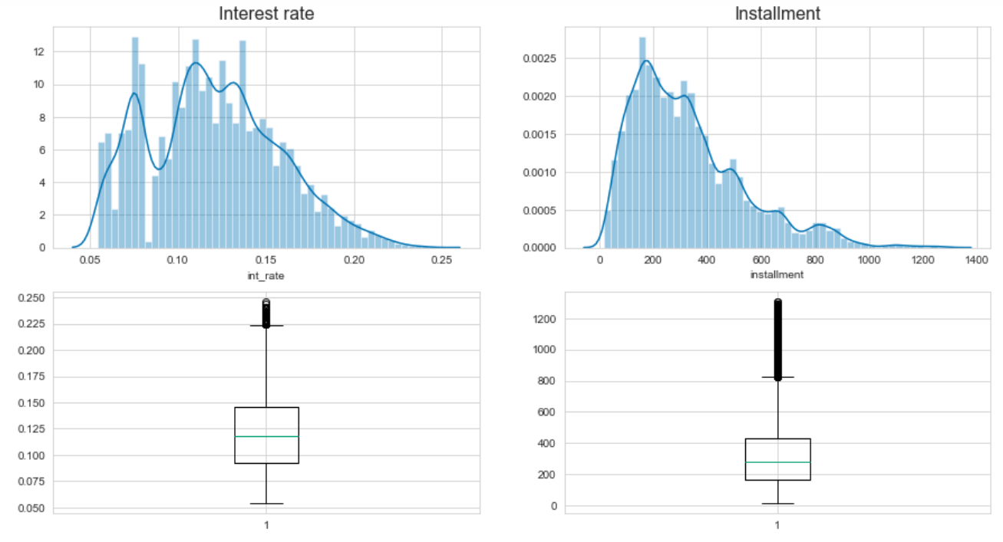
Analysis – Univariate
Very few loans given at 8% interest rate

Slide 13
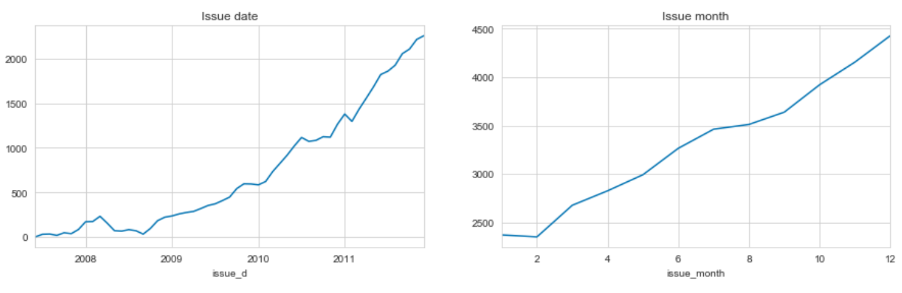
Analysis – Univariate
Almost linear growth in loans since 2009
Almost linear growth in loans starting March throughout Dec
Slope: Jan-Feb least number of loans issued| March-May, Jul-Sep growth rates of loan issuance are slower than May-Jul, Sep-Dec

Slide 14
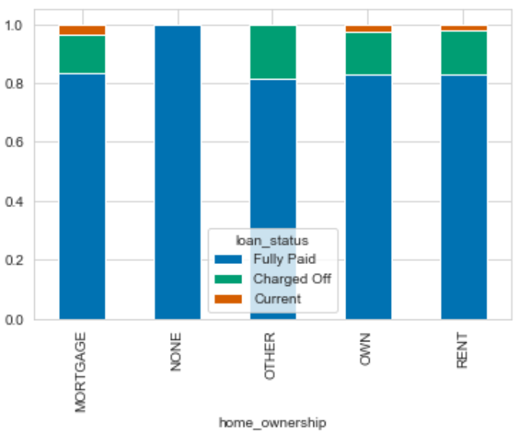
Analysis – BIVARIATE
Defaults tend to increase as this grades drop – Bad performance leads to increase in defaults. The bad performance could possibly be linked to some other factor.

Slide 15
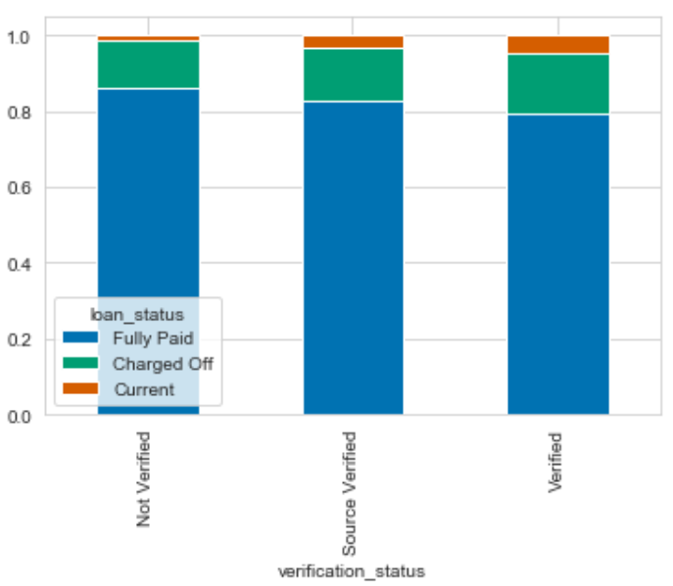
Analysis – Bivariate
Non verified accounts seem to be doing better as their default rate is lower

Slide 16
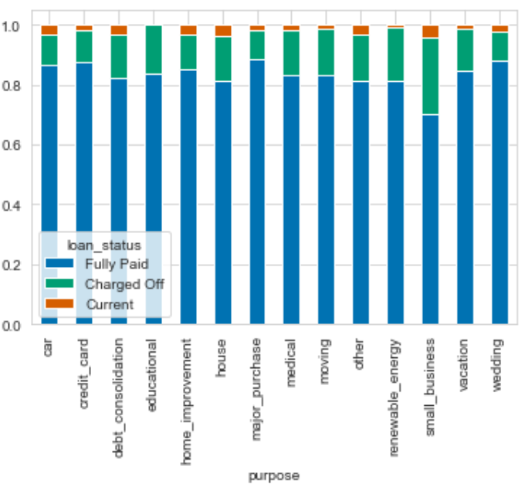
Analysis – Bivariate
Small business seem to have the highest proportion of defaults when compared with other purposes

Slide 17
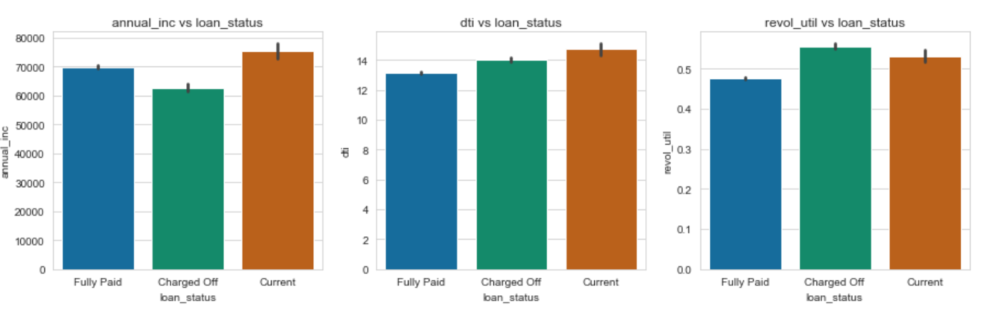
Analysis – Bivariate
Delinquency is high for lower annual income.
Higher DTI for Charged off customers opposed to Fully paid
Charge off frequencues higher for high revol_util

Slide 18
Recommendations
Small Business' have defaulted more. They are potential for higher interset rates and also proper due diligence
Reduce the high interest loans for 60 months tenure as they have high propensity for default
Higher interest rates should be charges to borrowers with debt-to-income ratio
Focused effort required to tap low experience customers
Focused effort required to tap customers with rented and mortgaged houses
More discretion and due diligence required while sanctioning loans to some states - CA, FL and NY

